Slide 1
Clustering Airports by Operational Efficiency

Slide 2
Objective
Objective: Cluster airports together using operations, cancellation, and airport identification data
Purpose: Find out which airports are least efficient
No additional data used

Slide 3
Features Used for Clustering
Average Gate Departure Delay
Average Taxi-out Delay
Average Airborne Delay
Average Taxi-in Delay
Average Block Delay
Percent On-time Airport Departures
Percent On-time Gate Arrivals

Slide 4
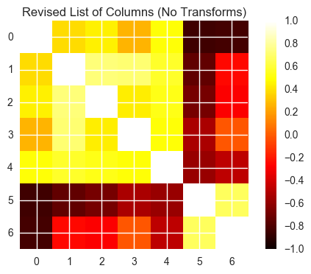
Features cont’d.
Created 4 unique standardizations of the data:
No transform, Normalizer transform, Robust Scaler transform, Min Max Scaler transform
Not concerned about any colinearity; it will be ignored in the eigenspace reduction
Also, no columns were multicolinear

Slide 5
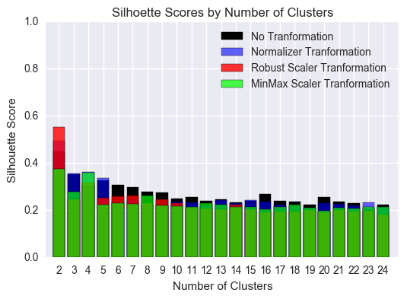
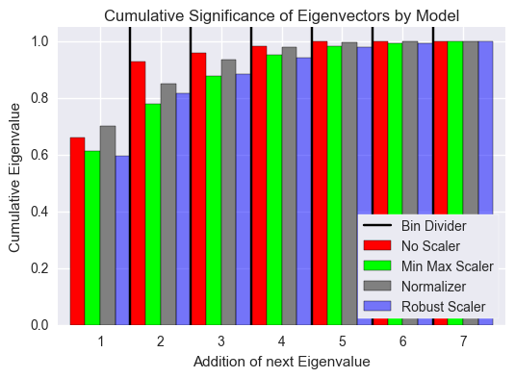
Pre-PCA Cluster Analysis
Used K-Means to generate clusters
Used silhouette scores and explained variance ratio
Used 4 Principal Components
Focused on 3 to 4 clusters

Slide 6
Discovering Identification Trends
Ran RF, GB, and ET over 4 unique datasets for 3, 4, 5, 6 and 7 clusters
3 and 4 clusters were the best
Features Used: Total Flights, Departure Cancellations, Departure Diversions
Averaged accuracy scores over 25 random states to find realistic score
Accuracy Scores | X0 | X1 | X2 | X3
3 Clusters
RFC | 0.483684211 | 0.719286492 | 0.671819172 | 0.558278867
GB | 0.498947368 | 0.670713508 | 0.64209695 | 0.545517429
ET | 0.495570175 | 0.695827887 | 0.654422658 | 0.591416122
4 Clusters
RFC | 0.490263158 | 0.521873638 | 0.653037037 | 0.544716776
GB | 0.464429825 | 0.472489107 | 0.624740741 | 0.503028322
ET | 0.531052632 | 0.525571895 | 0.648 | 0.507124183

Slide 7
Accuracy Scores
Looked at RFC X1 and RFC X2 for 3 clusters
Looked at RFC X2 for 4 clusters
Settled on RFC X1 for 3 Clusters
3 Clusters | RFC X1 | 5 | 2 | 1
 |  | 3 | 10 | 0
 |  | 1 | 0 | 1
 | RFC X2 | 1 | 1 | 4
 |  | 0 | 4 | 0
 |  | 1 | 0 | 12
4 Clusters | RFC X2 | 0 | 0 | 2 | 0
 |  | 0 | 1 | 1 | 2
 |  | 1 | 1 | 11 | 0
 |  | 0 | 2 | 0 | 2

Slide 8
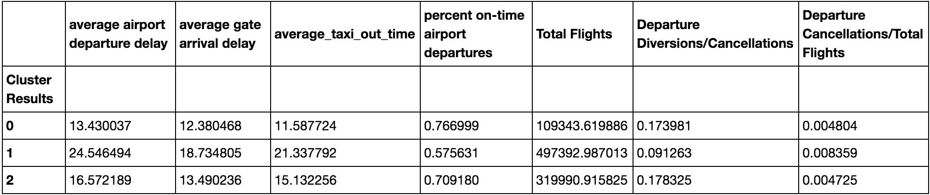
Checking RFC X1 at 3 Clusters
Ran the RFC X1 model for feature importance’s
Also matched target labels with corresponding airports to check cluster results
The clusters represented the operations efficiency
Feature | Importance
Total Flighs | 0.264310
Departure Diversions | 0.240770
Departure Cancellations | 0.232677
State NY | 0.041929
State CA | 0.030772
State FL | 0.025091
State DC | 0.022938
State KY | 0.021834

Slide 9
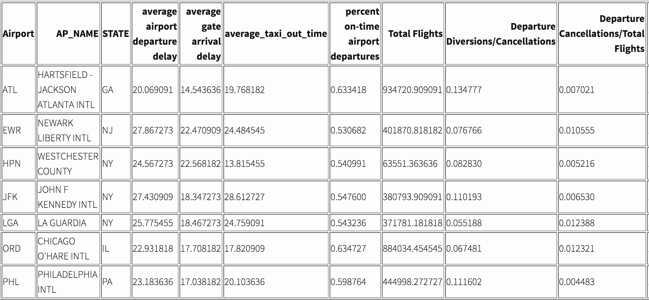
Target Labels Associated Airports
Target cluster with worst operational efficiency seems well chosen

